Slide 1
Chapter -2
INTELLECTUAL PROPERTY
Department of Information Technology
Raya university

Slide 2
INTELLECTUAL PROPERTY
Intellectual property is a term used to describe works of the mind—such as art, books, films, formulas, inventions, music, and processes—that are distinct, and owned or created by a single person or group.
IP: is a term for any intangible asset -- something proprietary that doesn't exist as a physical object but has value.
Software IP, is a computer code or program that is protected by law against copying, theft, or other use that is not permitted by the owner.
Software IP belongs to the company that either created or purchased the rights to that code or software. Any unauthorized use of it by someone else is illegal.

Slide 3

Cont…
Essentially, every business must be concerned with patents, copyrights, and trademarks. These are all types of asset protections, even though the assets might be intangible. Your business assets might include equipment, real estate, or cash reserves tucked away in a bank account, but you probably also own something else: intellectual property.
Intellectual property refers to things like inventions or designs for an invention, manuscripts, books, creative licenses, or logos.
Patents, copyrights, and trademarks protect different types of intellectual property businesses can own. Understanding how each protection works will help you secure your intellectual property, which might be the most valuable asset your business possesses.

Slide 4
What is the difference between copyright and trademark? What is a patent?
Copyrights, trademarks, and patents differ in what kind of intellectual property they each protect.
Copyright vs Trademark vs Patent
The United States government’s laws surrounding intellectual property can be hard to understand if you aren’t a lawyer. Each type of intellectual property involves different laws and requirements, so there are some basic concepts to understand before going forward with your patent, copyright, or trademark.

Slide 5
A copyright protects original works, such as art, literature, or other created work.
A trademark protects names, short slogans, or logos.
A patent protects new inventions, processes, and compositions of matter (such as medicines). Importantly, ideas cannot be patented—your invention must be embodied in a process, machine, or object.
Trademark vs Copyright
The simplest way to understand the difference between a copyright and trademark is size.
A copyright is for entire works, like books, songs, software code, or photographs. Trademarks are for logos, phrases, or designs that identify your brand or business.

Slide 6
What’s a Patent?
A patent is a special license issued by the US Patent and Trademark Office (USPTO) that gives you the exclusive right to make, use, or sell an invention for a set period of time.
Patents aren’t all the same; there are 3 kinds to choose from based on your situation.

Slide 7
Intellectual Property(IP)
Is Software an Intellectual Property?
Intellectual property is a type of intangible property created by the mind, such as inventions, works of art and literature, designs, names, or images. Software also fits into this category.
Intellectual property law recognizes 4 types of intellectual property that can be protected. Let’s take a look at these types and how they apply to software IP.

Slide 8
Intellectual Property(IP)
The 4 Types of Intellectual Property
Globally, an owner of intellectual property rights like trademark, patent, industrial designs…etc shall take all the necessary safeguard means of protecting them.
Intellectual property is protected through copyright, patent, and trade secret laws and trade mark.
Patent law: A patent is the exclusive right to produce, use, and sell an invention, patent law protects inventions;
A patent right shall belong to the inventor. But if two or more persons have jointly made an invention the right to the patent shall belong to them jointly.
Patents generally expire after a given period, usually 20 years. This gives the inventor a sufficient amount of time to fully benefit from the exclusive production and sale of their invention.
Patent is an invention that is new, involves an inventive step and is industrially applicable, then it will be patentable.

Slide 9
Patentable Inventions
An invention shall be considered new if it is not anticipated by prior art.
An invention shall be deemed as involving an inventive step.
An invention shall be considered as industrially applicable where it can be made or used in handicraft, agriculture, fishery, social services and any other sectors.
Novel: No technology like it has yet been produced
Useful: Your invention provides a clear and reasonably accessible benefit to the user.
Non-obvious: Your invention must have a component of innovation and can’t be the obvious next step in the development of an existing technology

Slide 10
Non-Patentable Inventions
The following shall not be patentable:
Inventions contrary to public order on morality
Plant or animal varieties or essentially biological processes for the production of plants or animals.
Schemes, rules or methods for playing games or performing commercial and industrial activities and computer programmes.
Discoveries, scientific theories and mathematical method
Notes:
ARP: Address Resolution Protocol

Slide 11
Cont’d…
Software patents are extremely valuable for vendors because they can protect aspects of their product that other intellectual property laws cannot.
However, patents can be difficult to obtain and the application process can drag out considerably.
Furthermore, different countries have different approaches to the patentability of software.

Slide 12
Copyright
A copyright is the exclusive right to distribute, display, performs, or reproduces an original work in copies or to prepare derivative works based on the work.
It gives the owner the exclusive right to copy, modify, and distribute or sell those copies or modifications of the property to the public.
Copyright protection is granted to the creators of “original works of authorship in any tangible medium of expression, now known or later developed, from which they can be perceived, reproduced, or otherwise communicated, either directly or with the aid of a machine or device.”
The author may grant this exclusive right to others. As new forms of expression develop, they can be awarded copyright protection.

Slide 13
Cont’d.…
The types of work that can be copyrighted include architecture, art, audiovisual works, choreography, drama, graphics, literature, motion pictures, music, pictures, sculptures, sound recordings, and other intellectual works.
To be eligible for a copyright, a work must fall within one of the preceding categories, and it must be original.
Copyright law has proven to be extremely flexible in covering new technologies; thus, software, video games, multimedia works, and Web pages can all be protected.
However, evaluating the originality of a work is not always a straightforward process, and disagreements over whether or not a work is original sometimes lead to litigation.
The use of copyrights to protect computer software raises many complicated issues of interpretation.

Slide 14
Cont’d…
Software copyright could cover the specific code used in the program or elements in the user interface. Copyright is automatically obtained by the creation of the original work.
Unlike with patents, there’s no need to go through an application process.
Copyright is usually applicable for the duration of the copyright owner’s life plus 50 years, or for 75 years from publication in the case where the software was created by the employee of a company.

Slide 15
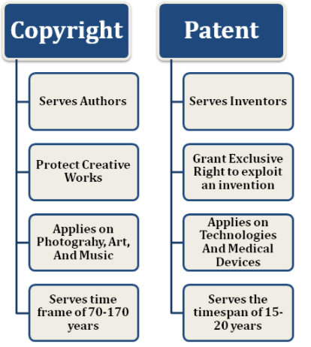
In case You confuse copyright Vs Patent

Slide 16
Trade secrets
A trade secret is a process, tool, mechanism, or formula that is not publicly available and is kept secret by its owner.
A trade secret is defined as business information that represents something of economic value, has required effort or cost to develop, has some degree of uniqueness or novelty, is generally unknown to the public, and is kept confidential.
In the shoemaker example, the unique design of the shoe would fall under copyright, while the special way the shoemaker produces those shoes would be considered a trade secret because the competitor can’t discover it just by studying or taking apart the finished product

Slide 17
Cont’d…
Trade secrets can be protected by law as long as the owner makes reasonable effort to keep it a secret and no one else has discovered it independently.
It’s illegal for someone to spy on your company and steal a trade secret, but if they figure it out by reverse engineering or by developing it themselves, it’s fair game.
Trade secret law protects only against the misappropriation of trade secrets.
If competitors come up with the same idea on their own, it is not misappropriation; in other words, the law does not prevent someone from using the same idea if it was developed independently.

Slide 18
Cont’d…
There are no time limitations on the protection of trade secrets, as there are with patents and copyrights.
There is no need to file an application, make disclosures to any person or agency, or disclose a trade secret to outsiders to gain protection.
While patents can be ruled invalid by the courts, meaning that the affected inventions no longer have patent protection, this risk does not exist for trade secrets.
No filing or application fees are required to protect a trade secret.
Because of these advantages, trade secret laws protect more technology worldwide than patent laws do

Slide 19
Trademarks
A trademark is a symbol, phrase, name, or other type of expression used to distinguish a particular product or brand.
Names of brands or products are often marked as trademarks using a trademark symbol: ™ for unregistered trademarks, and ® for registered ones.

Slide 20
How to Protect Software Intellectual Property?
It’s pretty easy for a shoemaker to protect his property: he locks up his store at the end of the day so no one can enter. But how does a software vendor protect the code they developed and ensure that no one steals their product or uses it in an unauthorized manner?
Your first layer of software intellectual property protection is doing your homework long before your product is released to the public:
Hire a good lawyer or legal team to clarify exactly which rights you have and how best to protect them.
File for patents and register trademarks where possible.

Slide 21
Cont’d…
Carefully screen employees and independent contractors and have them sign non-disclosure agreements before working with you.
Store and work with your data on secure devices and follow all best practices for data security.
Once your technology is ready for distribution on the market, what you need to protect your software is a robust licensing management system

Slide 22
Reading Assignment
<<How to Protect Software IP with Licensing Management>>
Consider this scenario:
When someone pays for the right to use an apartment, first they must sign a contract or agreement with the owner. Once that has been signed, the owner hands the renter or buyer a key they can use to access the property.
N.B: A software license is both the contract and the key

Slide 23
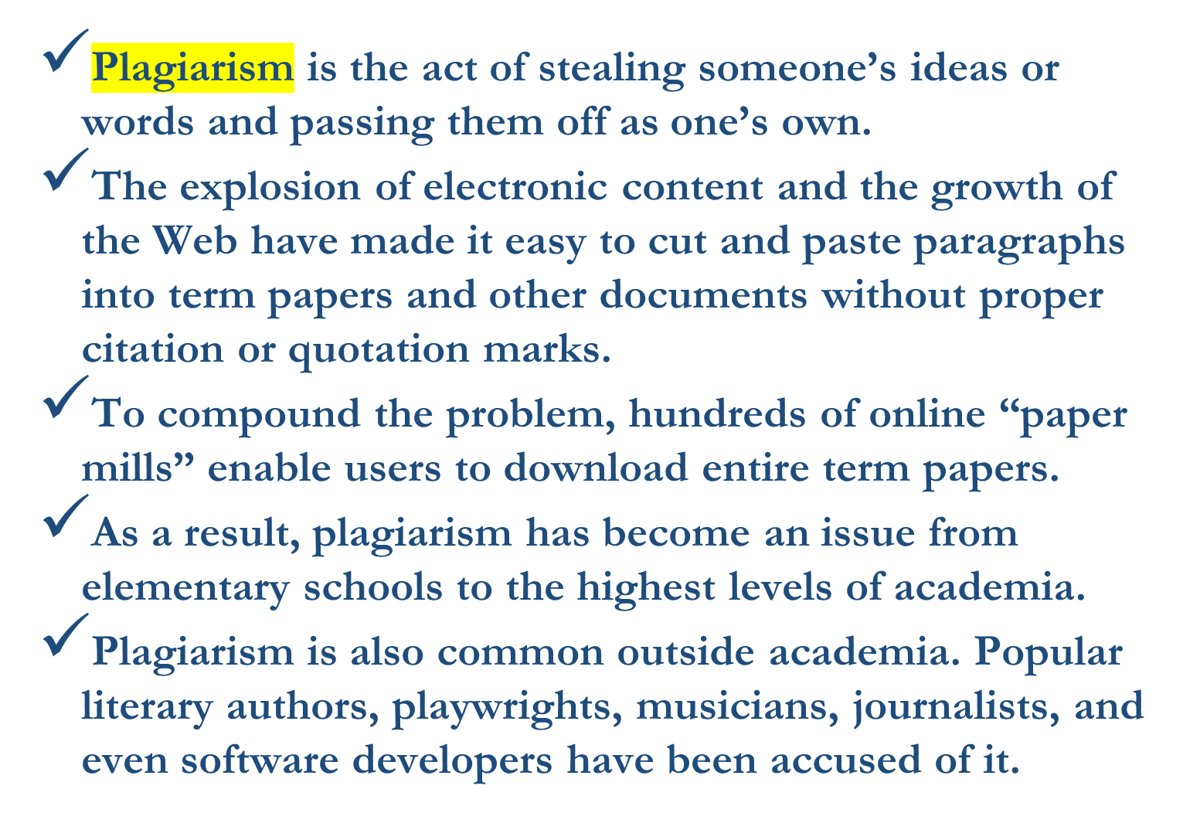
Key Intellectual Property Issues

Slide 24
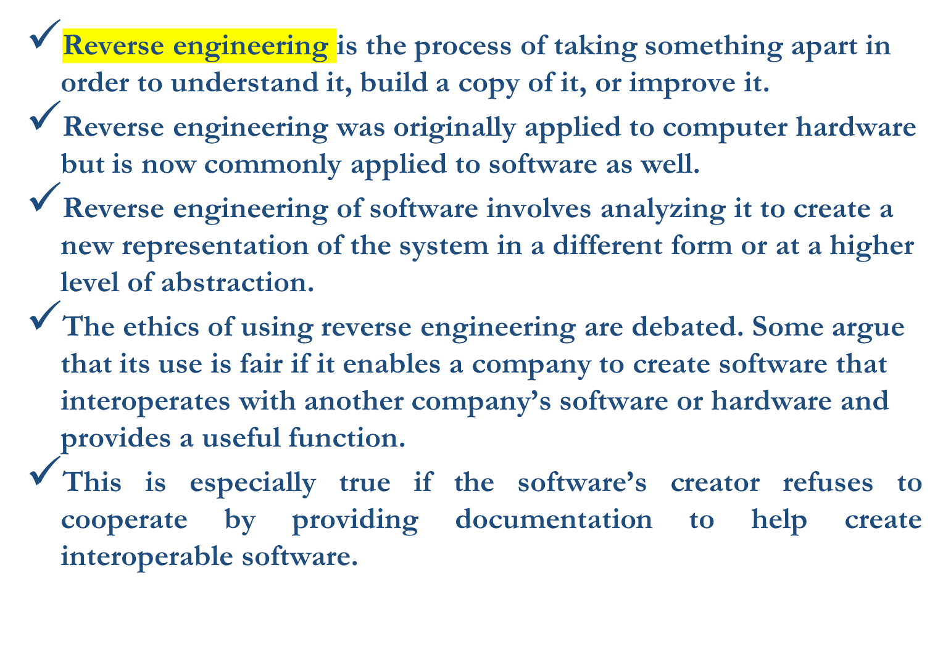
Key Intellectual Property Issues

Slide 25
Open Source Code
The makers of proprietary software have not made their source code available, but not all developers share that philosophy.
Open source code is any program whose source code is made available for use or modification, as users or other developers see fit.
The basic premise behind open source code is that when many programmers can read, redistribute, and modify a program’s code, the software improves.
Programs with open source code can be adapted to meet new needs, and bugs can be rapidly identified and fixed.
Open source code advocates believe that this process produces better software than the traditional closed model.

Slide 26
Cybersquatting
A trademark is a logo, package design, phrase, sound, or word that enables a consumer to differentiate one company’s products from another’s.
Consumers often cannot examine goods or services to determine their quality or source, so instead they rely on the labels attached to the products.
Trademark law gives the trademark’s owner the right to prevent others from using the same mark or a confusingly similar mark on a product’s label.
Ethiopia has a federal system that stores trademark information; merchants can consult this information to avoid adopting marks that have already been taken.
Trademarks can be renewed forever—as long as a mark is in use.
Cybersquaters registered domain names for famous trademarks or company names to which they had no connection, with the hope that the trademark’s owner would eventually buy the domain name for a large sum of money.
The main tactic organizations use to circumvent cybersquatting is to protect a trademark by registering numerous domain names and variations as soon as the organization knows it wants to develop a Web presence (for example, UVXYZ.com, UVXYZ.org, and UVXYZ.info).

Slide 27
Thank You!

